Slide 1
Numerical Integration

Slide 2
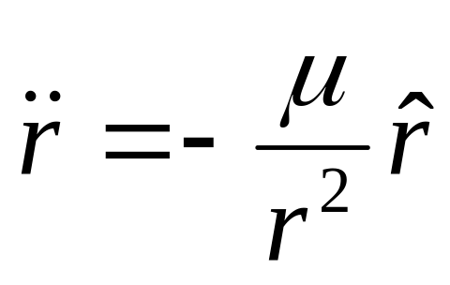
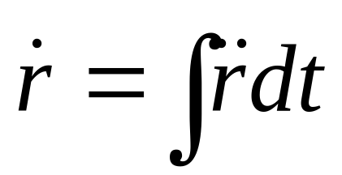
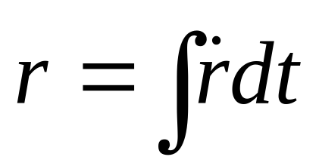
Integration
In order to find out where a satellite will be in the future we can integrate the EOM

Slide 3
Integration
However, for many problems finding an analytic solution for an integration is often very difficult if not impossible
This is the case with satellite motion so we have to turn to other methods
In this case we will use numerical integration

Slide 4
Numerical Integration
Simulink is ideal for many numerical integration problems
Instead of analytically integrating equations, Simulink does a numerical integration

Slide 5
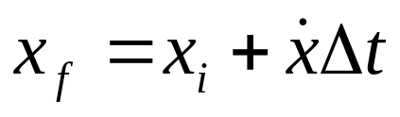


Numerical Integration
With numerical integration, the computer uses slope information to estimate the value at a future time
Here it can be seen that the estimate is not that great
function
estimate

Slide 6


Numerical Integration
However, if smaller steps are taken and the slope is reevaluated at each step a better result is obtained
If even smaller steps are taken, the results get better yet
function
estimate

Slide 7
Numerical Integration
By using special methods (like using weighted averages of slopes) we can get much better results without having to take such small steps
Methods like Runge-Kutta fall in this category

Slide 8
Numerical Integration
The next page shows a Simulink program that integrates the equations of motion for a ballistic trajectory (like our badintro program)

Slide 9
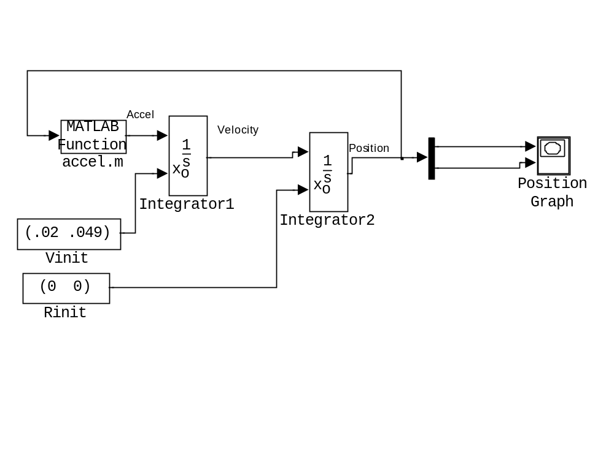
Discussion about this model starting with the upper left:
  Acceleration is computed based on the position of the object.
  Acceleration is integrated giving velocity
  Velocity is integrated giving position (which is fed back to compute acceleration)
  Because we have two integrations there are two sets of initial conditions.
  The vertical black bar is a Demux which separates the x and y values
  Finally there is an XY Graph to plot x vs. y

Slide 10
Numerical Integration
The accel.m block on the previous page that computes acceleration is a block that calls a Matlab function. The function is listed on the next page, but it is just a simple m-file

Slide 11
Acceleration Block
  function y = accel(u)
  %%%%%%%%%%%%%%%%%%%%%%%%%%%%%%%%%%%%%%%%%%%%%%%%%%%%%%%%%%%%%%%%%%%%
  % This specific function computes the acceleration of an object in a
  % two dimensional problem.
  %
  % Inputs
  % u = position vector (x,y) in km
  %
  % Outputs
  % y = acceleration vector (x,y) in km/s^2
  %
  %%%%%%%%%%%%%%%%%%%%%%%%%%%%%%%%%%%%%%%%%%%%%%%%%%%%%%%%%%%%%%%%%
  % compute the distance from the center of Earth
  r = 6378.137 + u(2);
  % Set the horizontal acceleration equal to zero
  xaccel = 0;
  % Use two body motion to compute the vertical acceleration
  yaccel = -398600.5/r^2;
  % Create output acceleration vector
  y = [xaccel;yaccel];

Slide 12
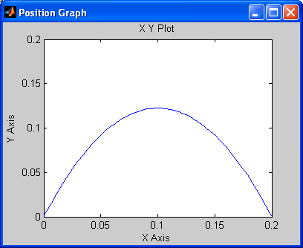
Numerical Integration
Now build the model above for yourself
Output from XY Graph:

Slide 13
Hints
Initial value blocks are Constants from Sources (with [x;y] values in km as properties)
Integrator blocks are found in Continuous (they must be opened to set the initial condition source to “external”, otherwise they use an initial value of zero)
Demux comes from Signal Routing
XY Graph is obviously a Sink, but it needs to have the min/max values reset
The Matlab function block is found in User Defined Functions

Slide 14
Hints
The base units are seconds and km (not meters)
Note that the values passed from block to block are not scalars. They are (x,y) vectors or derivatives of them. The exception is to the right of the Demux (vertical bar), it divides the vector into two separate values.

Slide 15
Hints
To split a signal (line), right click anywhere on the line and drag a second line away from it to the destination that you want
Do not name the Simulink model the same as any of your m-files
If you get: Error evaluating MATLAB function in 'accel/accel.m'. MATLAB error message: Simulink model accel was called with too few arguments
You probably named your Simulink model accel.mdl and you have an accel.m file, which confuses Simulink.

